Slide 1

Hotel Aggregator Analysis using Power BI
By
Keerthana K R

Slide 2
1
2
3
4
5
6
Contents
Problem Statement
Problem Objective
Data Cleaning and Preparation
Key Insights
Outcomes
Recommendations

Slide 3
Analyzing a hotel aggregator dataset using Power BI. Explore listings, hosts, reviews, and availability to uncover trends and factors affecting listing performance. Focusing on metrics like pricing, availability, host attributes, and review scores to generate actionable insights for enhancing listing quality and competitiveness.
Problem Statement

Slide 4
Project Objective
Geographical Insights:
Visualize the distribution of listings on a map to identify popular neighborhoods.
Explore the geographical concentration of listings and host locations.
Pricing and Availability Analysis:
Analyze pricing trends based on property types, room types, and accommodation capacity.
Investigate the availability of listings over time and identify peak periods.
Host Performance:
Evaluate host characteristics, including superhost status, response times, and verification methods.
Explore correlations between host attributes and listing performance.
Review Scores and Guest Satisfaction:
Examine review scores and their impact on overall listing performance.
Identify areas for improvement based on specific review categories.
Property Type and Room Analysis:
Analyze the distribution of property types and room types.
Explore trends in the popularity of specific accommodation setups.

Slide 5
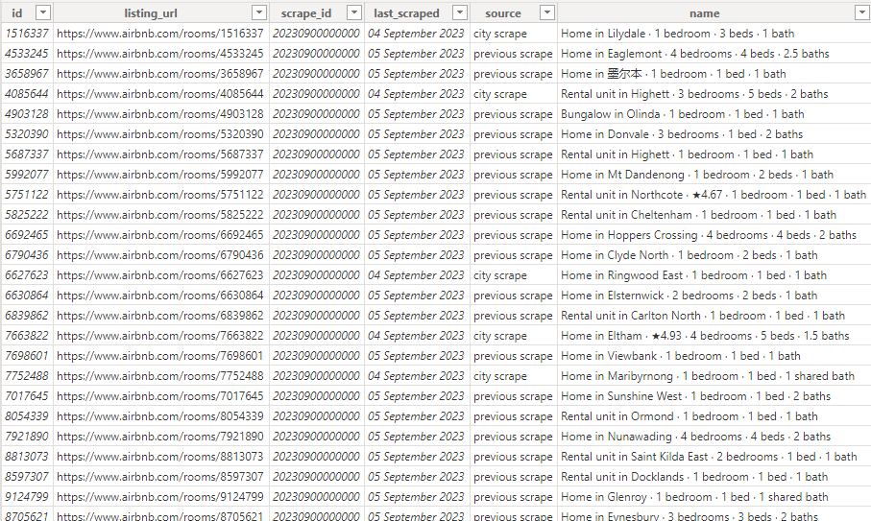
Dataset view

Slide 6
Dataset Cleaning and Preparation
1
2
3
Removing Duplicates , null and irrelevant values
Loading dataset to PowerBI
Doing data exploration and Analysis process

Slide 7
Key Insights

Slide 8
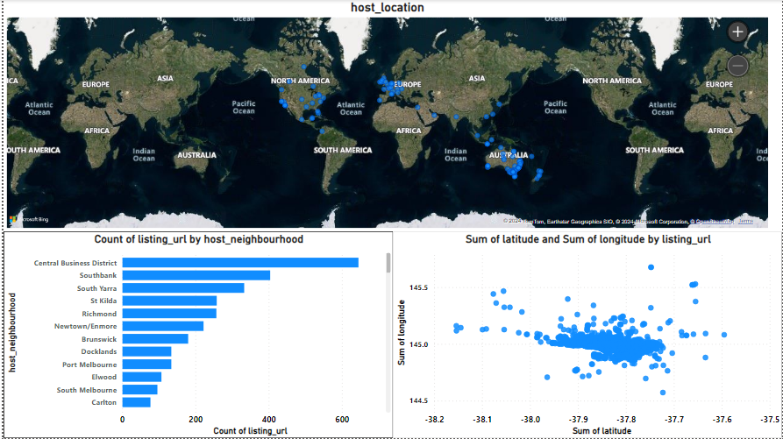
Geographical Insights

Slide 9
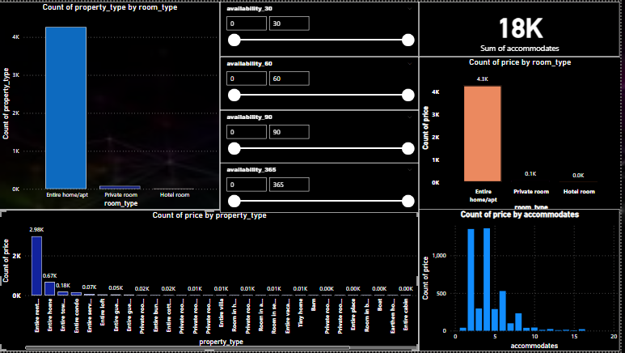
Pricing and Availability Analysis

Slide 10
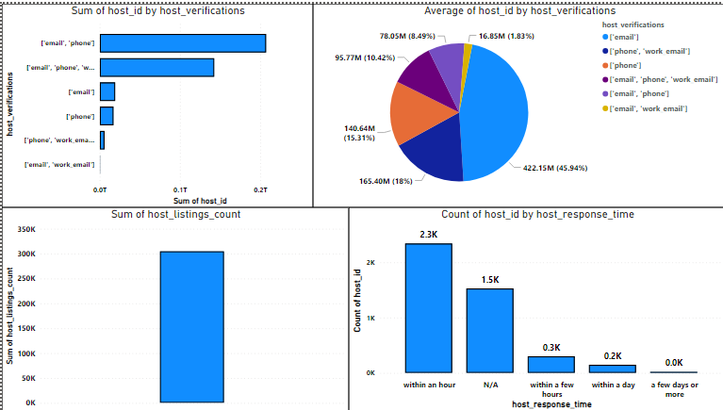
Host Performance

Slide 11
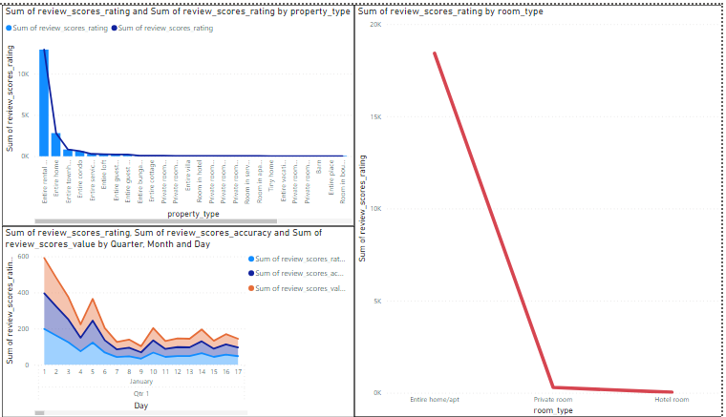
Review Scores and Guest Satisfaction

Slide 12
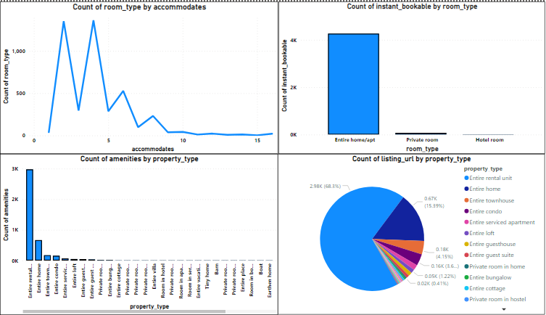
Property Type and Room Analysis

Slide 13
Outcomes
Host location is highly spreaded across Australia.
Count of listing is highest in central business district.
Price of entire room is high compare to other.
Host verification is done more through email.
Usually, host reponse with in an hour.
For entire room, both review score and rating is highest.
Entire home is instantly bookable.

Slide 14
Recommendations
Expand areas across the world rather than focusing on a country.
Host should maintain quick response.
Make use of other verfication methods instead of only email.
Focus on increasing review score by providing other facilities.
Focus more on communication, because review score is less in communication.
Creating a budget friendly price can increase revenue over other room type and property type.

Slide 15
Thank You

